Slide 1
Coursera Capstone
IBM Applied Data Science Capstone Project
New Indian Restaurant in Kuala Lumpur, Malaysia
Vishal Gawai
Oct 2019

Slide 2
Business Problem:
Kuala Lumpur, Malaysia is a great tourist attraction for many Indians. With rising India tourists, it provides great opportunity for new clients to open an Indian Restaurant to meet the rising demand of tourists.
Objective:
To analyze and identify new location where opening an Indian Restaurant can provide a great business opportunity to new business.
What is the best place to open a new Indian Restaurant in Kuala Lumpur, Malaysia ?

Slide 3
Data Information:
Data Gathering:
Neighborhoods list in Kuala Lumpur.
Coordinates of Neighborhoods.
Venue details for Indian Restaurant.
Data Source:
List of Neighborhoods from Wikipedia.
Get Coordinates of Neighborhoods using Geocode package.
Details for Indian Restaurant using Foursquare API.

Slide 4
Methodology:
Get Neighborhood list using Beautiful Soup Package.
Geocoder package to get Coordinate details.
Venue Details of Indian Restaurant using Foursquare API.
Group Neighborhood data and take mean frequency of occurrence of Venues categories.
Sort Venues by Indian Restaurant.
Using k-means algorithm, perform clustering.
Using Folium library, visualize the data.

Slide 5
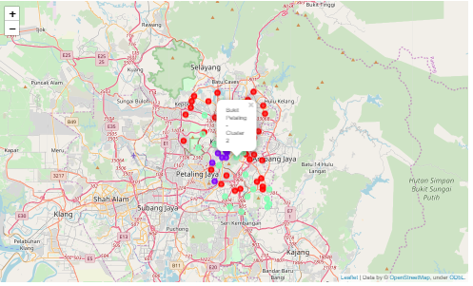
Results:
The Neighborhood has been categorized in 3 Clusters.
Cluster 0: Neighborhood with least concentration of Indian Restaurants.
Cluster 1: Neighborhood with very high concentration of Indian Restaurants.
Neighborhood with moderate concentration of Indian Restaurants.

Slide 6
Recommendation:
Cluster 1 has the maximum number of Indian restaurants present and is hugely populated.
Cluster 2 has moderate count of Indian restaurants which adequate opportunities.
Cluster 0 has the least density of Indian restaurants providing the best neighborhoods in Kuala Lumpur to open new restaurant.

Slide 7
Conclusion:
Through our analysis, we can conclude that neighborhoods in Cluster 1 is already concentrated with high number of Indian Restaurants and would provide bad opportunity to open new restaurants.
Cluster 0 is least populated and Cluster 2 has moderate count of Indian restaurants providing the best chances for new Indian restaurants to thrive and grow.
New Clients planning to open an Indian restaurants should focus on neighborhoods in cluster 0 and 1.

Slide 8
Thank You

